Slide 1
CO2 and CFC Sensors
The Nine Horsemen
Melissa Griffin, Adam Packard, Alli Porter, Quinn Roberts, Karina Winn

Slide 2
INTRODUCTION
CFCs Location of CFCs in the atmosphere We expect most of the CFCs to be in the upper atmosphere because the direction of the wind current is coming from the North West. | CO2 Discover where the CO2 is coming from Originally a back-up experiment
Notes:
CFCs: Because it is coming from the North west the CO2 is most likely coming from East Asia rather than LA or New England.
Why we have two instruments…CFC issues: not certain the instrument will be able to recognize the concentration and record data.
Basic Ozone Layer Science | US EPA
NOAA Global Monitoring Laboratory - Halocarbons and other Atmospheric Trace Species
NOAA Global Monitoring Laboratory - Halocarbons and other Atmospheric Trace Species

Slide 3
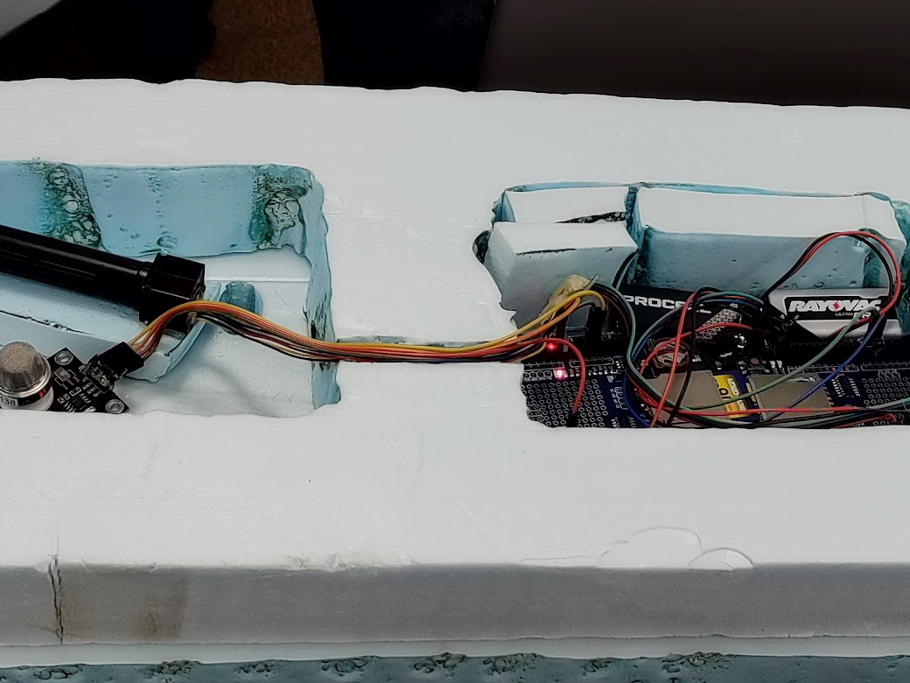
PROCEDURE
Researching
Rewiring and Debugging
Lot and lots of testing
Prepping for flight
Day of Flight
Notes:
Talk about the process, your favorite parts and/or least favorite parts of the process. What were you excited about?
What went wrong?
CFC the SD card was corrupted then the new one worked inconsistently
Expectations of data, no cfc in ozone
Bus is a Binary Unit System

Slide 4
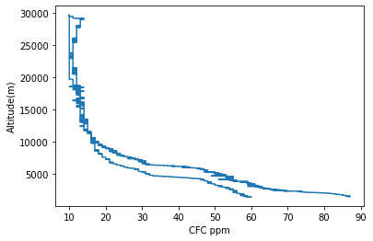
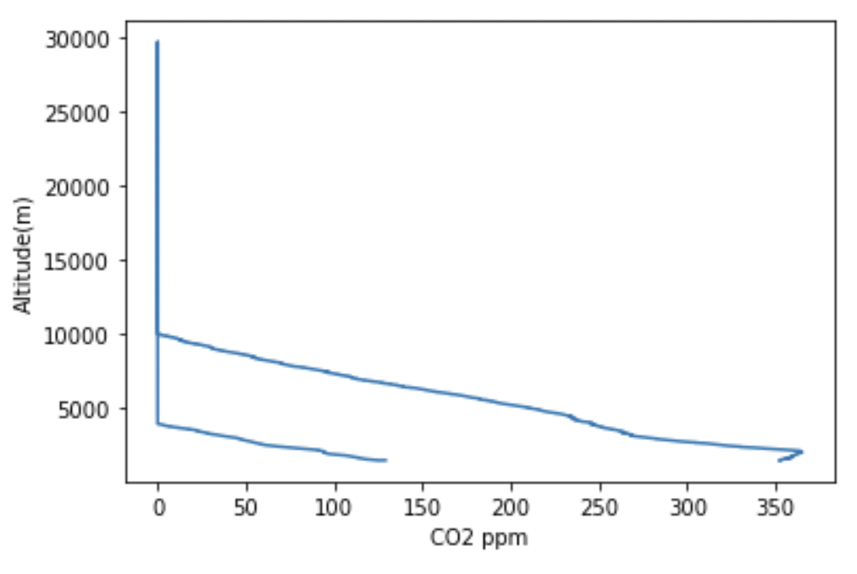
DATA
CFC Data
CO2 Data
Notes:
Talk about the data just a little bit, but don’t analyze it. Just point out a few interesting spots on the graph that we will explain later. For example, for the CO2 graph it goes to 0 ppm from 10 to 30 km and it should have had at least something.
Ozone layer: between 15-30km is 90%

Slide 5
ANALYSIS
CFC
Uncertainties of our measuring device is +/- 50 ppm +/- 5% of the reading
CO2
Dropping to 0 ppm at about 5000 m was unexpected
CO2 sensor takes a while to adjust
+/- 50 ppm +/- 5% of the reading
Notes:
Our data found CFC in the ozone
Found other data, but graphs were for specific CFCs.

Slide 6
RESULTS
CO2
Reads 0 from 10 km to 30 km… very suspicious…
Too cold for CO2 probe?
CFCs
There were 10-15 ppm CFCs between 15000 and 30000 meters
Notes:
Results, state what we found and what we think is the most likely analysis of the data.

Slide 7
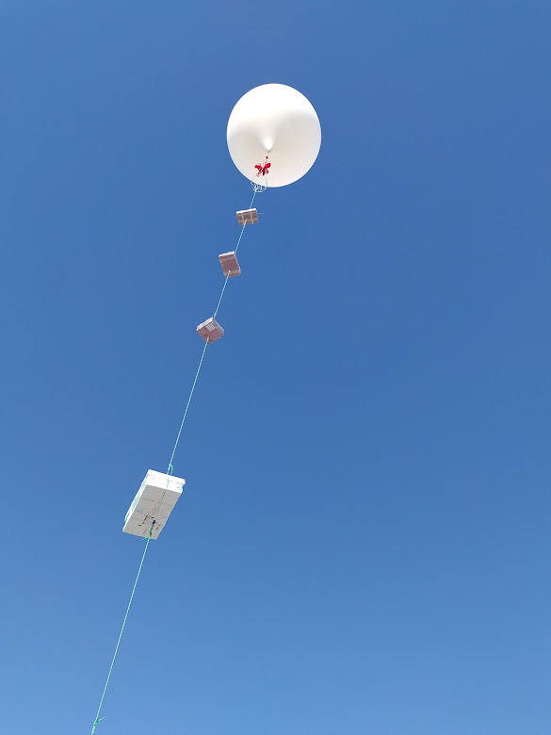
CONCLUSION
Our sensor picked up CFCs in
the ozone layer!
Further analysis and comparison to
other CO2 data needed
Notes:
Also talk about what we would change if we were to do the experiment again. For example, maybe different hand warmers to see if it is a temperature problem.
If we were do do this again…
-adjust temperature design of box
-research more about temperature
and CO2 at high altitudes

